Slide 1
Module 10 ”LINQ”

Slide 2
Agenda
Extension Methods
Anonymous Types
Introducing LINQ
First Look at LINQ Query Expressions
LINQ Query Keywords
More Query Operator Methods
Query Variations

Slide 3

Defining Extension Methods
Extension methods let you extend types with your own methods
Even if you don’t have the source or the types are not yours
Must be static and defined in a static class
The first parameter contains this and determines the type being extended
Extension methods can have any number of parameters
static class MyExtensions
{
public static string ToMyTimestamp( this DateTime dt )
{
return dt.ToString( "yyyy-MM-dd HH:mm:ss.fff" );
}
}
Notes:
The method is not compiled with the DateTime type, but as an “add-on” method importing separately

Slide 4
Invoking Extension Methods
Extension methods can be invoked at the instance level
Alternatively, the method can be invoked statically
Visual Studio 2012 has special IntelliSense for extension methods
DateTime dt = DateTime.Now;
Console.WriteLine( dt.ToMyTimestamp() );
DateTime dt = DateTime.Now;
Console.WriteLine( MyExtensions.ToMyTimestamp( dt ) );

Slide 5
Using Extension Methods
The static class containing the extension methods must be in scope for the extension methods to be used
Extension methods are indeed extending – not inheriting!
No access to private or protected members
All access is through the supplied parameter
Can extend interfaces as well, but implementation must be provided
public static string ToMyTimestamp( this DateTime dt )
{
return dt.ToString( "yyyy-MM-dd HH:mm:ss.fff" );
}
Notes:
Show scope example where “using xxx” must be included

Slide 6
Agenda
Extension Methods
Anonymous Types
Introducing LINQ
First Look at LINQ Query Expressions
LINQ Query Keywords
More Query Operator Methods
Query Variations

Slide 7
Creating Anonymous Types
Combining implicitly typed variables with object initializer syntax provides an excellent shorthand for defining simple classes called anonymous types
The compiler autogenerates an anonymous class for us to use
This class inherits from System.Object
Members are read-only!
var myEquipment = new { Manufacturer = "Nintendo",
Make = "Wii",
Controllers = 4 };
Console.WriteLine( "I have a {0} {1} with {2} controllers",
myEquipment.Manufacturer,
myEquipment.Make,
myEquipment.Controllers );
Notes:
Run program
Reveal its type (use ReflectOverAnonymousType method)

Slide 8
Equality of Anonymous Types
Anonymous types come with their own overrides of System.Object methods
ToString()
Equals()
GetHashCode()
The == and != operators are however not overloaded with Equals()!
The exact references are still compared
Notes:
Run the accompanying example demonstrating these points

Slide 9
Restrictions to Anonymous Types
Anonymous types can be nested arbitrarily
Some restrictions do apply to anonymous types
Type name is auto-generated and cannot be changed
Always derive directly from System.Object
Fields and properties of anonymous types are always read-only
Anonymous types are implicitly sealed
No possibility of Custom methods, operators, overrides, or events
var myFancyEquipment = new
{
Manufacturer = "Microsoft",
Make = "Xbox 360",
XboxLive = new { Name = "Komatoze", Membership = MembershipType.Gold }
};
Notes:
But anonymous types are excellent for quickly modeling the shape of data instead of encapsulating functionality…!

Slide 10
Agenda
Extension Methods
Anonymous Types
Introducing LINQ
First Look at LINQ Query Expressions
LINQ Query Keywords
More Query Operator Methods
Query Variations

Slide 11
Motivation for LINQ
LINQ = Language INtegrated Query
Several distinct motivations for LINQ
Uniform programming model for any kind of data
A better tool for embedding SQL queries into type-safe code
Another data abstraction layer
…
All of these descriptions to some extent hold true
Notes:
Motivation for LINQ is different for every person you ask as each individual stressing distinct aspects of LINQ
Briefly discuss each motivational pillar
New feature in C# 3.0. The sole reason for the previous module!

Slide 12
LINQ Components
LINQ to Objects
LINQ to XML
LINQ to SQL
LINQ to DataSet
LINQ to Entities
Parallel LINQ
…
We will focus on LINQ to Objects in this module
Later we will see
LINQ to XML
LINQ to Entities
Notes:
Briefly discuss each. The list of components grow with time.
Mention that there is more LINQ in the book.
This course focuses on LINQ to Objects, which are LINQ over .NET objects implementing IEnumerable<T>
LINQ is strongly typed and extendable

Slide 13
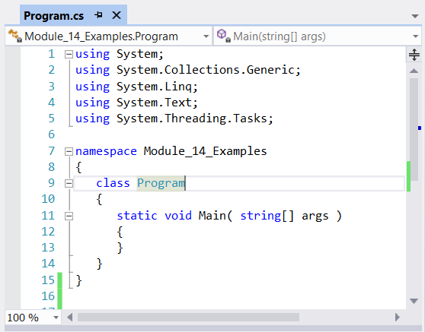
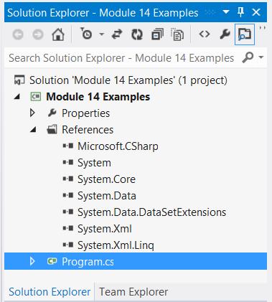
Starting LINQ to Objects
Main LINQ features live in System.Core.dll in the System.Linq namespace
Notes:
LINQ to Objects is facilitated out-of-the-box when creating a new application project
From now on we will call it “LINQ” instead of “LINQ to Objects”

Slide 14
Agenda
Extension Methods
Anonymous Types
Introducing LINQ
First Look at LINQ Query Expressions
LINQ Query Keywords
More Query Operator Methods
Query Variations

Slide 15
A First Example
Find all games with more that 18 characters in the title
string[] wiiGames = {
"Super Mario Galaxy",
"FIFA 09",
"Guitar Hero III",
"Wii Sports",
"Wii Fit",
"Legend of Zelda: Twilight Princess"
};
IEnumerable<string> query = from g in wiiGames
where g.Length >= 18
select g;
foreach( string s in query )
{
Console.WriteLine( s );
}
Notes:
Give a flavor of why this accomplishes the task.
Explain that this is the nature of SQL queries albeit the order in the syntax is changed.
Run the program and see the results.

Slide 16
Implicitly Typed Variables
Query results can be of a multitude of types
Innocently-looking modifications might change underlying type
Make all query variables implicitly typed…!
int[] numbers = {10, 20, 30, 40, 1, 2, 3, 8};
IEnumerable<int> query = from i in numbers where i < 10 select i;
foreach( int i in query )
{
Console.WriteLine( i );
}
int[] numbers = {10, 20, 30, 40, 1, 2, 3, 8};
var query = from i in numbers where i < 10 select i;
foreach( var i in query )
{
Console.WriteLine( i );
}
Notes:
Type is IEnumerable<int>. The same foreach from previous slide cannot be used, so change that variable to var
Try doing a “select i * 1.25”, which makes the expression an IEnumerable<double>, so change that query variable to var

Slide 17
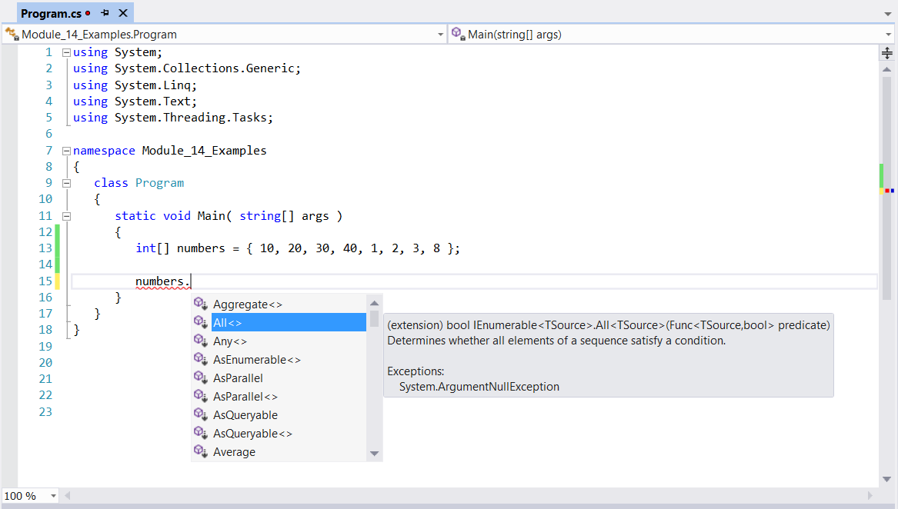
Enumerable Extension Methods
The System.Linq.Enumerable class provides a lot of extension methods
Notes:
How was the previous slide even possible??? Arrays do not implement IEnumerable<T>!!!
Solution: LINQ provides a huge amount of extension methods to let existing types play well with LINQ query expressions and provide further operators
Show IntelliSense on arrays first without the using System.Linq then with it.
This is the helper class which makes stuff happen!

Slide 18
Deferred Execution
Query expressions are not evaluated until they’re enumerated!
This is called Deferred Execution
You can force evaluation through the Visual Studio 2012 debugger
Use the Results View of the query variable
int[] numbers = { 10, 20, 30, 40, 0, 1, 2, 3, 8 };
var query = from i in numbers where i < 10 select 87 / i;
foreach( var i in query )
{
Console.WriteLine( i );
}
Notes:
This is to avoid a lot of unnecessary computations which are not used anyway.
Clever!

Slide 19
Immediate Execution
You can force evaluation by using conversion extension methods
There are other such extension methods, e.g.
ToDictionary<T,K>
int[] numbers = { 10, 20, 30, 40, 0, 1, 2, 3, 8 };
var query = from i in numbers where i < 10 select i;
int[] intNumbers = query.ToArray();
List<int> listNumbers = query.ToList();

Slide 20
LINQ and Generic Collections
LINQ can query data in various members of System.Collections.Generic
Moreover, you can query generic collections of custom objects as well
Stack<int> stack = new Stack<int>( new int[]{ 42, 87, 112, 255 } );
var query = from i in stack where i < 100 select i;
List<Car> cars = new List<Car>() {
new Car{ PetName="Henry", Color="Silver", Speed=100, Make="VW" },
new Car{ PetName="Daisy", Color="Tan", Speed=90, Make="BMW" },
new Car{ PetName="Mary", Color="Black", Speed=55, Make="VW" },
new Car{ PetName="Clunker", Color="Rust", Speed=5, Make="Yugo" },
new Car{ PetName="Melvin", Color="White", Speed=43, Make="Ford" }
};
var query = from c in cars
where c.Speed > 90 && c.Make == "BMW"
select c;

Slide 21
LINQ and Nongeneric Collections
Nongeneric collections lack the IEnumerable<T> infrastructure for querying
This can be provided using the OfType<T> extension method
This method also filters entries not matching type
ArrayList cars = new ArrayList() {
new Car{ PetName="Henry", Color="Silver", Speed=100, Make="BMW" },
new Car{ PetName="Daisy", Color="Tan", Speed=90, Make="BMW" },
new Car{ PetName="Mary", Color="Black", Speed=55, Make="VW" },
new Car{ PetName="Clunker", Color="Rust", Speed=5, Make="Yugo" },
new Car{ PetName="Melvin", Color="White", Speed=43, Make="Ford" }
};
IEnumerable<Car> enumerableCars = cars.OfType<Car>();
var query = from c in enumerableCars
where c.Speed > 90 && c.Make == "BMW"
select c;
Notes:
First run example without enumerableCars.
Then with it.
To illustrate ToType<T>, try inserting a string and an integer into ArrayList.

Slide 22
Agenda
Extension Methods
Anonymous Types
Introducing LINQ
First Look at LINQ Query Expressions
LINQ Query Keywords
More Query Operator Methods
Query Variations

Slide 23
The from Clause
Range variables and data source are specified in the from clause
It can define the type of the range variable as well
Can in fact have multiple from clauses…
Stack<int> stack = new Stack<int>( new int[]{ 42, 87, 112, 255} );
var query = from i in stack where i < 10 select i;
ArrayList cars = new ArrayList {
new Car{ PetName="Henry", Color="Silver", Speed=100, Make="BMW" },
...
};
var query = from Car c in cars
where c.Speed > 90 && c.Make == "BMW"
select c;
Notes:
Can in fact have multiple From clauses

Slide 24
The where Clause
Filtering conditions are specified by a boolean expression in a where clause
This can be any boolean expression
Can have multiple where clauses also
List<Car> cars = new List<Car> {
new Car{ PetName="Henry", Color="Silver", Speed=100, Make="BMW" },
...
};
var query = from c in cars
where c.Speed > 90 && c.Make == "BMW"
select c;
var query = from c in cars
where c.Speed > 90
where SomePredicate( c )
select c;
Notes:
Show in example that condition can contain a method call etc.

Slide 25
The select Clause
Projections of results are done through the select clause
Projections can create new (anonymous) data types
List<Car> cars = new List<Car> {
new Car{ PetName="Henry", Color="Silver", Speed=100, Make="BMW" },
...
};
var query = from c in cars
where c.Speed > 90 && c.Make == "BMW"
select c.Make;
var query = from c in cars
where c.Speed > 90 && c.Make == "BMW"
select new { c.Make, c.Color };

Slide 26
The orderby Clause
Results can be sorted using the orderby clause
The order can be ascending (the default) or descending
List<Car> cars = new List<Car> {
new Car{ PetName="Henry", Color="Silver", Speed=100, Make="BMW" },
...
};
var query = from c in cars
where c.Speed >= 55
orderby c.PetName
select c;
var query = from c in cars
where c.Speed >= 55
orderby c.PetName descending, c.Color
select c;
Notes:
Try a few variations of criteria to order by in the accompanying example.
Can actually order by various clauses as well

Slide 27
Query Operators Resolution
These query operators are keywords with syntax highlighting and IntelliSense
But they are resolved as extension methods in the Enumerable class
You can use either syntax or use delegates instead of anonymous methods etc.
var query = from g in wiiGames
where g.Length >= 18
select g;
var query = wiiGames.Where( g => g.Length >= 18 )
.OrderBy( g => g )
.Select( g => g );
Notes:
This sets the scene for investigating more non-keyword extension methods shortly.

Slide 28
Agenda
Extension Methods
Anonymous Types
Introducing LINQ
First Look at LINQ Query Expressions
LINQ Query Keywords
More Query Operator Methods
Query Variations

Slide 29
Count<T>
You can compute the number of items in the result set with Count<T>
This forces an evaluation of the query expression!
string[] wiiGames = {
"Super Mario Galaxy",
"FIFA 09",
"Guitar Hero III",
"Wii Sports",
"Wii Fit",
"Legend of Zelda: Twilight Princess"
};
var query = from g in wiiGames
where g.Length >= 18
select g;
Console.WriteLine( "{0} games match the query", query.Count() );
Notes:
These are a few more handy extension methods from System.Linq.Enumerable
Can be invoked directly on the query as well: (from g in … select g).Count<string>();

Slide 30
Reverse<T>
You can reverse the result sequence with Reverse<T>
Note that this does not evaluate the query expression…!
string[] wiiGames = {
"Super Mario Galaxy",
...
};
var query = ( from g in wiiGames select g ).Reverse();

Slide 31
Set Operations: Except<T>
Differences between queries can be computed with Except<T>
Do you think this will evaluate the query expression? ☺
Union<T>, Intersect<T>, and Except<T> constitute the set operations (Distinct<T> is also helpful!)
string[] wiiGames = {
"Super Mario Galaxy", ...
};
string[] xbox360Games = {
"Halo", ...
};
var query = ( from g in wiiGames select g ).Except(
from g in xbox360Games select g );
var query2 = wiiGames.Except( xbox360Games );
Notes:
The answer is NO!

Slide 32
Singleton Operations
A single element can be retrieved from a query result
First<T>
Last<T>
Single<T>
Each of these has an …OrDefault<T> version
FirstOrDefault<T>
LastOrDefault<T>
SingleOrDefault<T>
var query = wiiGames.Intersect( xbox360Games );
var first = query.First();
var last = query.Last();
var theOnlyOne = query.Single();
Console.WriteLine( first );
Console.WriteLine( last );
Console.WriteLine( theOnlyOne );

Slide 33
Partitioning Operators
Take() and Skip()
There are also
TakeWhile()
SkipWhile()
string[] wiiGames = {
"Super Mario Galaxy", ...
};
string[] xbox360Games = {
"Halo", ...
};
var query1 = wiiGames.Union( xbox360Games ).Take( 7 );
var query2 = wiiGames.Union( xbox360Games ).Skip( 3 );

Slide 34
Aggregation Operators
Aggregate() computes a running value
Other aggregation operators include
Count()
Sum()
Min()
Max()
Average()
int[] numbers = { 42, 87, 112, 176, 255 };
var result = numbers.Aggregate( ( product, i ) => product * i );
Console.WriteLine( "The product of numbers is " + result );

Slide 35
Agenda
Extension Methods
Anonymous Types
Introducing LINQ
First Look at LINQ Query Expressions
LINQ Query Keywords
More Query Operator Methods
Query Variations

Slide 36
Grouping
Use the group keyword or the GroupBy() method
Resulting query yields a set of keyed result groups
There is also a more sophisticated group into syntax
var query = from i in numbers
group i by i % 2;
foreach ( var group in query )
{
Console.WriteLine( group.Key );
foreach ( var i in group )
{
Console.WriteLine( "\t" + i );
}
}

Slide 37
Joins
Use the join keyword to join elements on equality
Other variations of join can be expressed in a number of ways…
var query = from c in customers
join o in orders on c.Id equals o.CustomerId
select new
{
Name = c.Name,
Product = o.Product
};
foreach ( var cop in query )
{
Console.WriteLine( "{0} bought {1}", cop.Name, cop.Product.Name );
}

Slide 38
Quiz: LINQ Query Expressions – Right or Wrong?
int[] numbers = {10, 20, 30, 40, 1, 2, 3, 8};
var query = from i in numbers where i select i;
List<Car> cars = new List<Car>() {
new Car{ PetName="Henry", Color="Red", Make="BMW", Speed=55}, ...
};
var query = from c in cars
where 40 <= c.Speed && c.Speed < 90 where c.Make.StartsWith( "v" )
select c.Color;
string[] wiiGames = { ... };
string[] xbox360Games = { ... };
var query = ( from g in wiiGames select g ).Except<Game>(
from g in xbox360Games select g );
var query = from c in cars
orderby c.PetName ascending, c.Speed descending
select new { Name = c.PetName, Model = c.Make };
Notes:
Wrong: Type of condition expression is int – not bool
Right
Wrong: Generic type of Except should be string – not Game (Hence: Better to leave it out altogether!)
Right

Slide 39
Summary
Extension Methods
Anonymous Types
Introducing LINQ
First Look at LINQ Query Expressions
LINQ Query Keywords
More Query Operator Methods
Query Variations

Slide 40
Question 1
01 02 { 03 public static bool IsPrime( ) 04 { 05 if ((number % 2) == 0) { number == 2; } 06 int sqrt = (int) Math.Sqrt(number); 07 08 for (int t = 3; t <= sqrt; t = t + 2) 09 { 10 if (number % t == 0) { return false; } 11 } 12 return number != 1; 13 } 14 }
You need to ensure the MyExtensions class implements the IsPrime() method on integers. Drag appropriate code segments to the correct locations?
public class MyExtensions
static class MyExtensions
protected static class MyExtensions
this int number
int number
this number

Slide 41
Question 2
You are creating an application calling a method, which returns an array of integers named customerIds. You declare and initialize an integer variable named idToRemove. You declare an array named filteredCustomerIds. You must meet the following requirements:
Sort the array from highest value to lowest value
Remove duplicate integers from the customerIds array
Remove the idToRemove value from the customerIds array.
Which code segment should you use?
filteredCustomerIds = customerIds.Distinct() .OrderByDescending( i => i ).ToArray();
filteredCustomerIds = customerIds.Distinct() .Where( i => i != idToRemove ) .OrderByDescending( i => i ).ToArray();
filteredCustomerIds = customerIds .Where( i => i != idToRemove ) .OrderByDescending( i => i ).ToArray();
filteredCustomerIds = customerIds.Distinct() .Where( i => i != idToRemove ) .OrderBy ( i => i ).ToArray();

